Slide 1


Exploring the chemical space boundaries of potential
candidates in liquid chromatography
using molecular descriptors
Alex Nikolopoulos | 14099306
1st examiner: Saer Samanipour
2nd examiner: Bob Pirok
Daily Supervisor: Denice van Herwerden

Slide 2










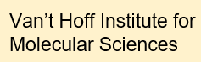
Non-targeted is our target!
Non-targeted workflows enable to create an unbiased overview of a sample
Each feature has multiple possible candidates
Is it possible to reduce the number of possible candidates?
Due to the intrinsically high number of features, identification can be cumbersome as well as expensive!
LC-MS is the dominant technique used in NTA
Workflow
Possible candidates
Data
Models
Assessment
Not possible candidates
Validation
Validation
2

Slide 3
How can we predict the retention of a compound?
Stationary phase
Mobile phase composition
Temperature
The retention time is greatly affected by the chromatographic conditions
Retention time inadequate for the study
Small change in any LC parameter
Retention time (t_{R}) will vary
Not reproducible results
The best way to normalize retention times is by using a retention index system
3

Slide 4
How can we predict the retention of a compound?
University of Athens (UoA) retention index
Kovat’s retention index
n-alkylamide retention index
Gas chromatography
Liquid chromatography
Liquid chromatography
n-alkylamide homologous series (C3-C14)
18 computationally selected compounds (not part of a homologous series)
n-alkane homologous series
Mainly used in GC column comparison and characterisation
Used in metabolomic studies, since it is MS-compatible
Novel retention index with a broader reference system
4

Slide 5
Which factors influence the retention index?
Retention indices are not influenced by the chromatographic conditions.
Therefore, r_{i} is only affected by the compound structure!
Compound structure
1D descriptors
2D descriptors
3D descriptors
PubChem fingerprints
Number of N atoms, molecular weight
Longest aliphatic chain, number of acidic groups, Crippen logP
Total molecular surface area, Petitjean shape index
Presence of SMARTS patterns
PaDEL is a computational tool used to calculate 2756 descriptors given a single compound SMILES
5

Slide 6
Descriptors acquisition
Training datasets
n-alkylamide: 1488 compounds and their experimental r_{i}
UoA: 1816 compounds and their experimental r_{i}
But can we use all 2756 descriptors provided by PaDEL?
Dataset used for application
SusDat NORMAN: 95115 compounds
PaDEL was used to calculate the descriptors of these datasets
6
Notes:
Mention that we have two different systems here!

Slide 7
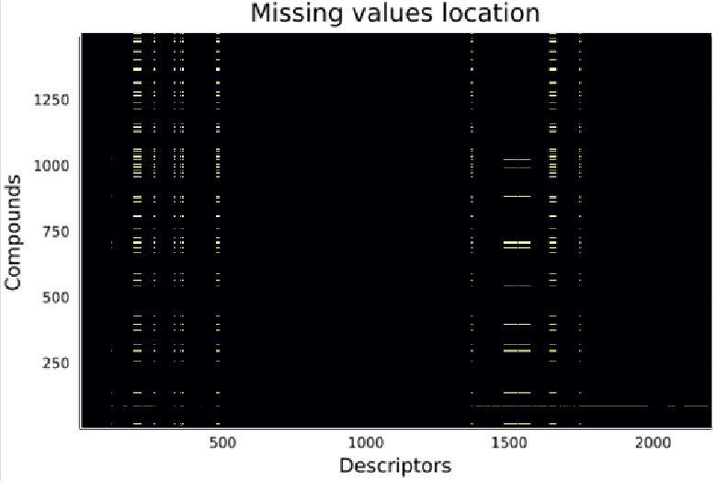
Descriptors selection and normalization
Training datasets
Descriptors selection
n-alkylamide: 1488 compounds and their experimental r_{i}
UoA: 1816 compounds and their experimental r_{i}
3-fold calculation for the n-alkylamide dataset
High variation between the calculations
Unstable descriptors
Descriptors with missing values
Dataset used for application
SusDat NORMAN: 95115 compounds
Descriptors of different order of magnitude
PaDEL was used to calculate the descriptors of these datasets
1170 useful descriptors
7
Notes:
Mention that we have two different systems here!

Slide 8
Model development
80% of each dataset is used as the training set of each model
Random forest model A
The remaining 20% is used as the test set for validation
n-alkylamide r_{i}
Descriptors
Random forest has three main hyperparameters to be tuned
UoA r_{i}
The maximum features per tree was set to the number of descriptors used divided by 3 ^{[1]}
Random forest model B
The other two hyperparameters must be optimized to increase the accuracy of the model
¹ Hastie, T.; Tibshirani, R.; Friedman, J. The Elements of Statistical Learning, 2nd ed.; Springer New York: New York, NY, 2009
8

Slide 9
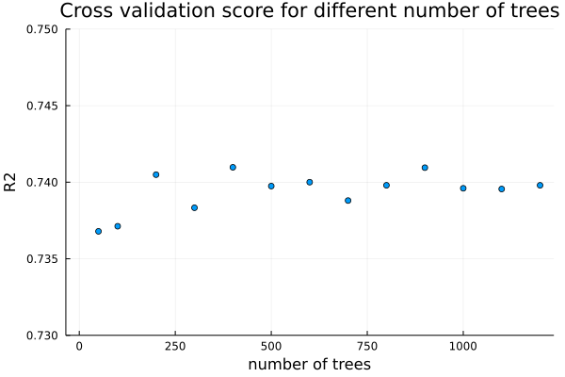
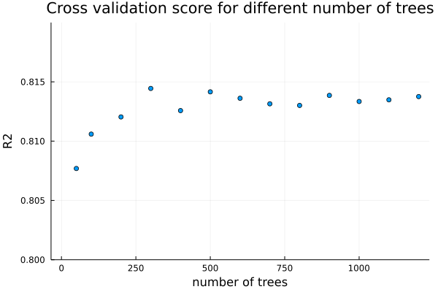
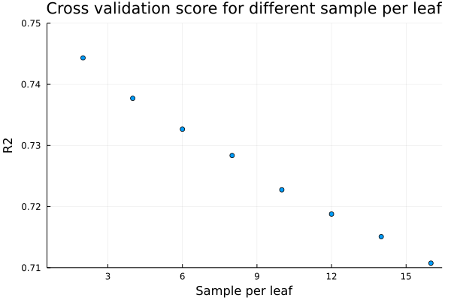
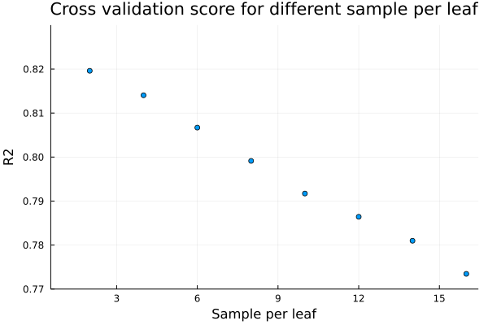
Model hyperparameters optimization
n-alkylamide dataset
UoA dataset
Optimization
The hyperparameters were optimized to maximize accuracy and avoid overfitting
 | n-alkylamide | UoA
No. of trees | 400 | 500
Sample per leaf | 4 | 4
We have two models able to predict accurately the retention indices!
9

Slide 10
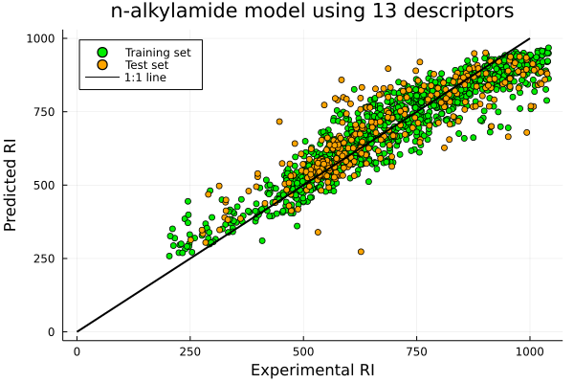
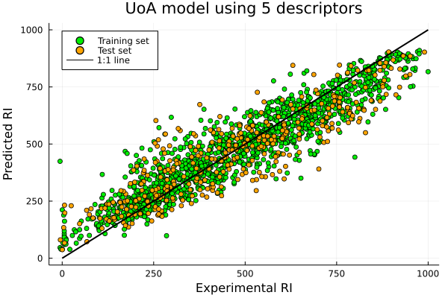
Models with reduced number of variables
However, using 1170 variables is computationally expensive, what if we use fewer descriptors?
Most important descriptors were found based on average variance reduction
New models were created with a small number of (the most important) descriptors
 | n-alkylamide | UoA
R² | 0.73 | 0.77
We have two models able to predict accurately and fast the retention indices!
10

Slide 11
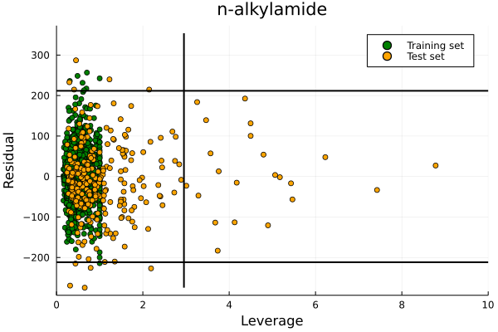
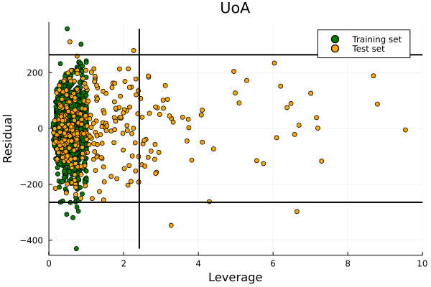
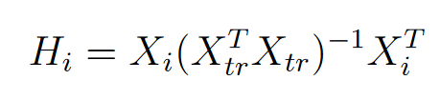
Applicability domain
Can our models give accurate predictions for any compound? What are the limitations?
Inaccurate
Accurate
No model based on a limited training set can function adequately for the compounds of the entire chemical space
Inaccurate
The applicability domain (AD) describes the model limits and is calculated with the leverage
Inaccurate
The leverage measures the similarity of a compound compared to the training set
Accurate
Inaccurate
11

Slide 12
Applicability domain
Can our models give accurate predictions for any compound? What are the limitations?
Inside
Outside
No model based on a limited training set can function adequately for the compounds of the entire chemical space
The applicability domain (AD) describes the model limits and is calculated with the leverage
The leverage measures the similarity of a compound compared to the training set
Inside
Outside
12

Slide 13
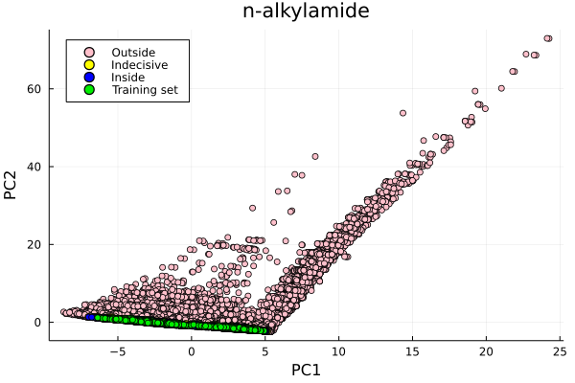
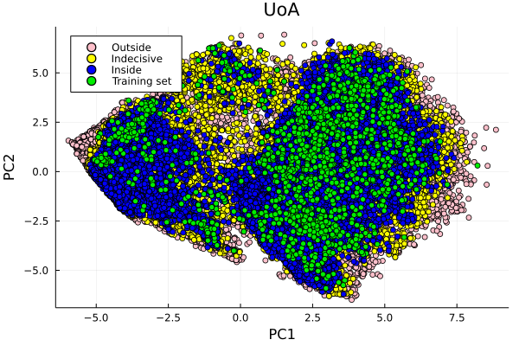
Principal component analysis
How similar are the compounds of the training sets with the compounds of the NORMAN dataset?
NORMAN
The n-alkylamide training set shows low similarity to the compounds of the NORMAN dataset
The UoA training set covers a great portion of the chemical space
13

Slide 14
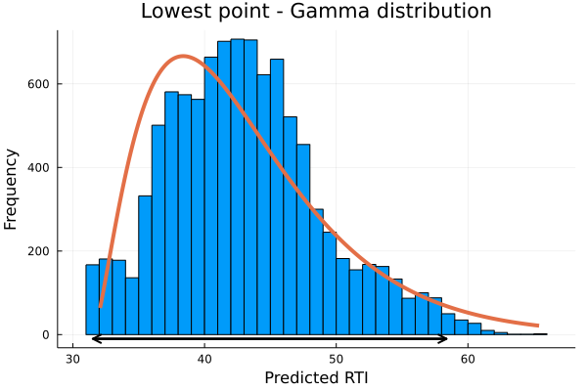
Retention index assessment
Can every compound be analyzed in a C18 column?
The descriptors of the lowest and highest points of each model were slightly changed over multiple iterations
Compounds of extremely low r_{i}
The low and high extrapolation areas were set at the 95% quantiles
No retention on the stationary phase
Elution at t₀
Unsuitable for LC analysis in a C18 column
Compounds of extremely high r_{i}
Strong adsorption to the stationary phase
Extremely long retention times
We have found the r_{i} ranges in which the compounds cannot be analyzed in a C18 column!
95% area
14

Slide 15


Overall assessment
Is every compound with “acceptable” retention indices compatible with a C18 column?
Group A
Group D
AD (n-alkylamide)
AD (UoA)
r_{i} (n-alkylamide)
r_{i} (UoA)
AD (n-alkylamide)
r_{i} (n-alkylamide)
Applicability domain
Predicted r_{i} assessment
Group B
Group E
Inside
Outside
Acceptable
Unacceptable
AD (n-alkylamide)
r_{i} (n-alkylamide)
AD (UoA)
r_{i} (UoA)
Let’s see how the NORMAN dataset is distributed into these groups!
Group C
Group F
AD (UoA)
r_{i} (UoA)
AD (n-alkylamide)
AD (UoA)
15

Slide 16
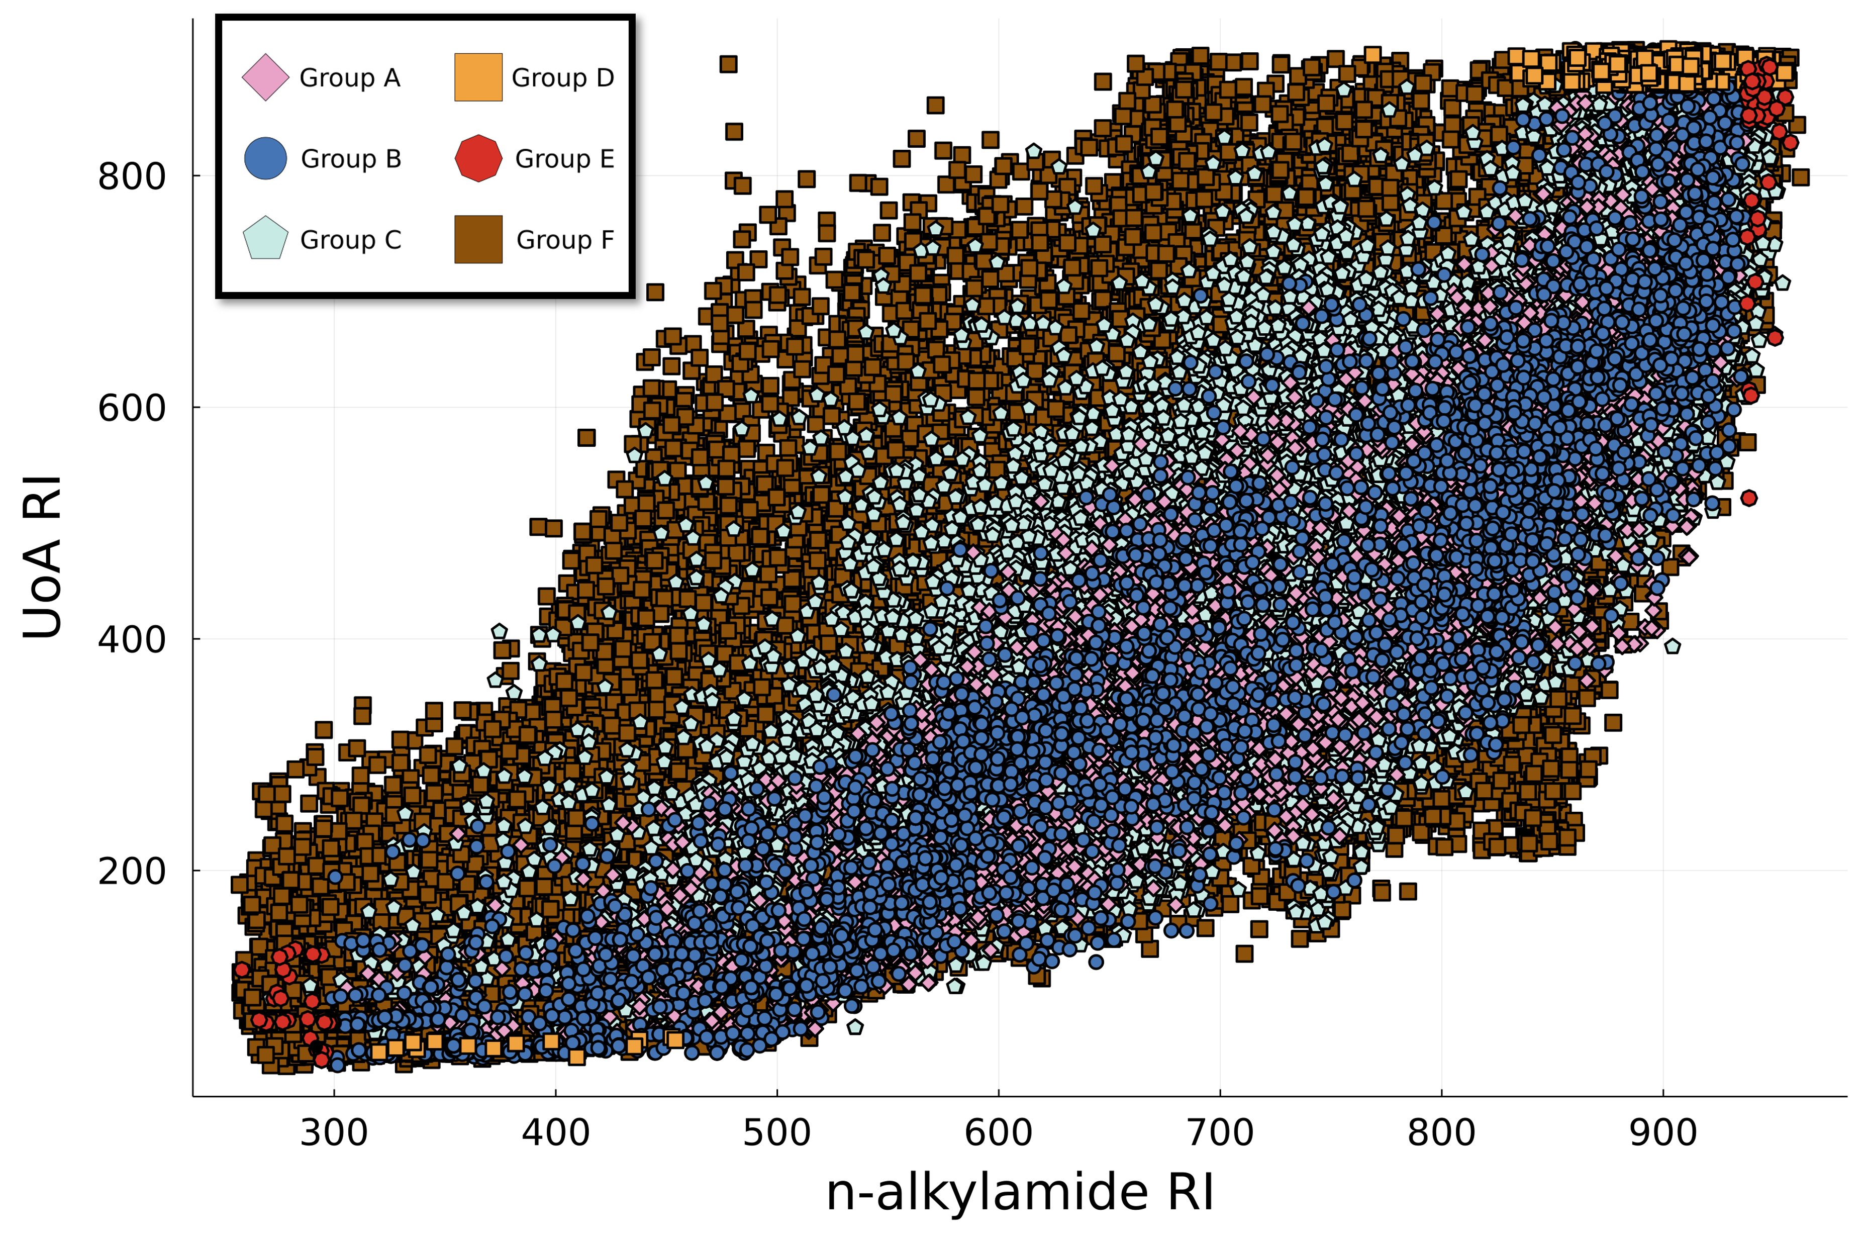
Overall assessment
Group A
Group D
AD (n-alkylamide)
AD (UoA)
r_{i} (n-alkylamide)
r_{i} (UoA)
AD (n-alkylamide)
r_{i} (n-alkylamide)
Group B
Group E
AD (n-alkylamide)
r_{i} (n-alkylamide)
AD (UoA)
r_{i} (UoA)
Group C
Group F
We have the classification of the NORMAN compounds based on their compatibility with RPLC analysis in a C18 column!
AD (UoA)
r_{i} (UoA)
AD (n-alkylamide)
AD (UoA)
16

Slide 17
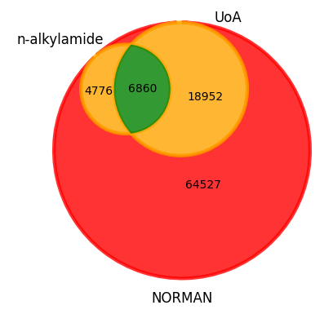
Distribution of the NORMAN dataset into assessment groups
Group A
Group D
AD (n-alkylamide)
AD (UoA)
r_{i} (n-alkylamide)
r_{i} (UoA)
7.2%
0.6%
AD (n-alkylamide)
r_{i} (n-alkylamide)
Group B
Group E
AD (n-alkylamide)
r_{i} (n-alkylamide)
5.0%
AD (UoA)
r_{i} (UoA)
0.1%
Group C
Group F
AD (UoA)
r_{i} (UoA)
19.9%
AD (n-alkylamide)
AD (UoA)
67.1%
17

Slide 18
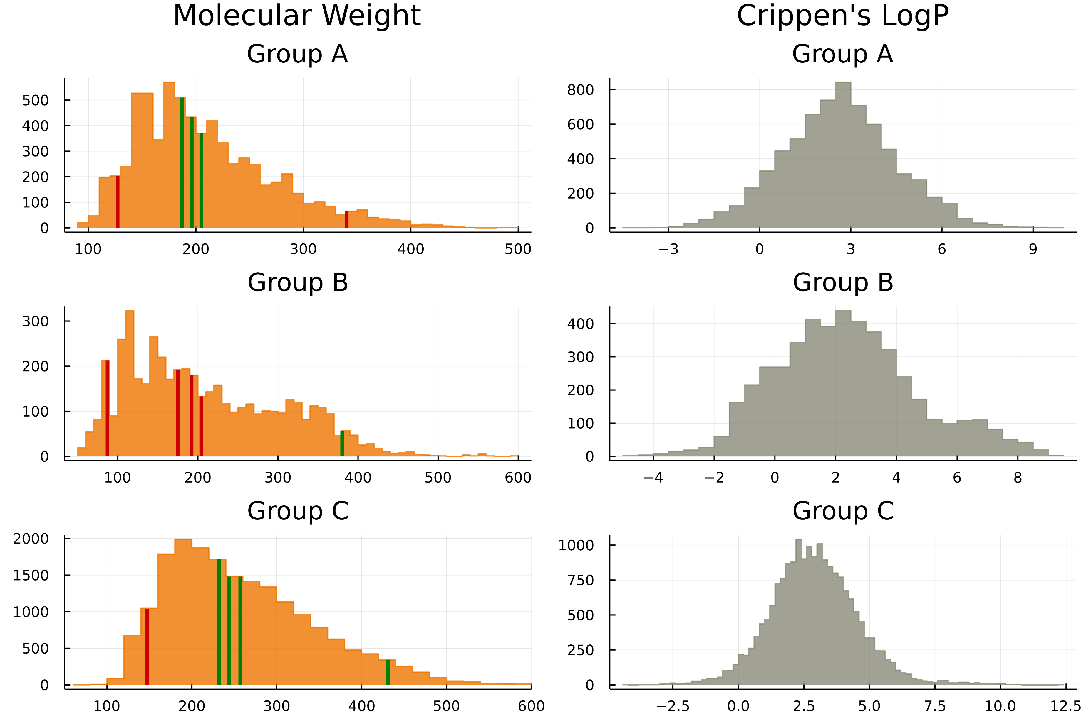
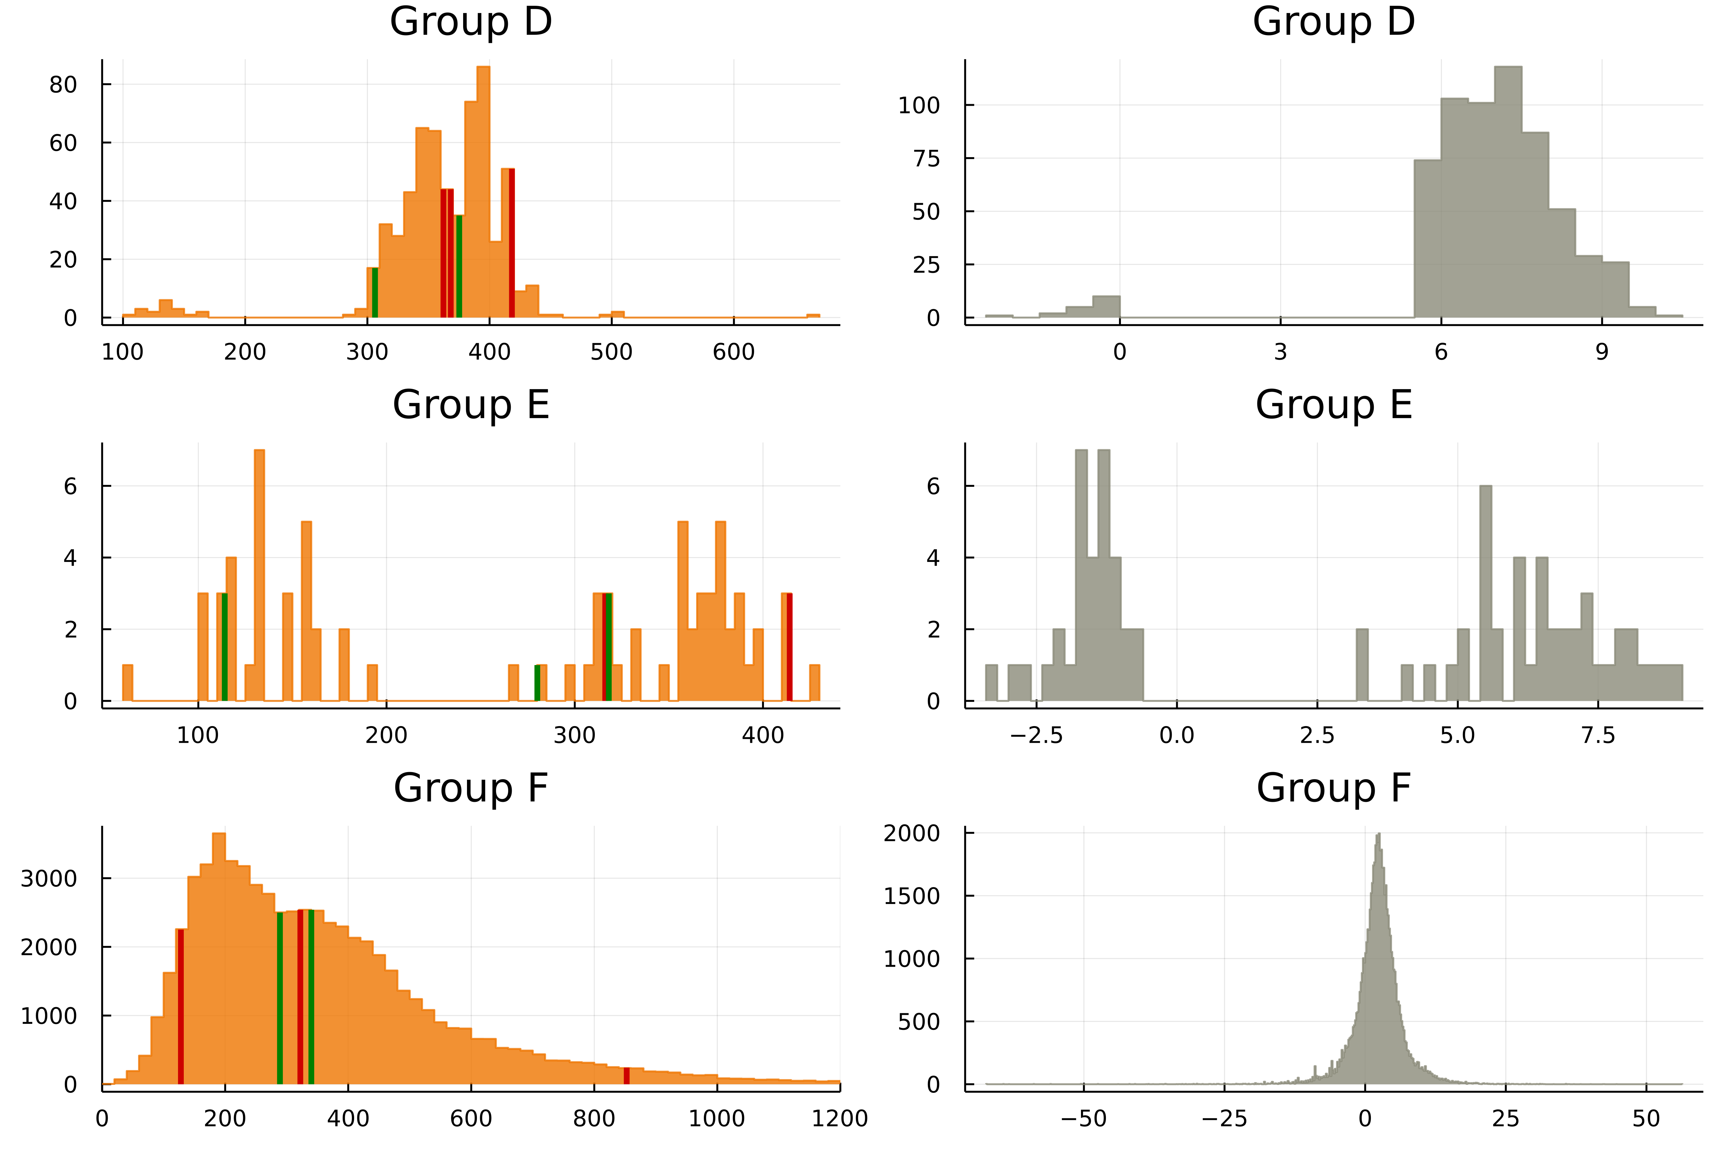
Assessment performance – Literature search
How well does our assessment function?
Selection of 5 compounds from each group
Literature search on the analysis of these compounds in a C18 column
 | True positive | True negative
Predicted positive | 8 | 7
Predicted negative | 7 | 8
A
B
C
D
E
F
18

Slide 19
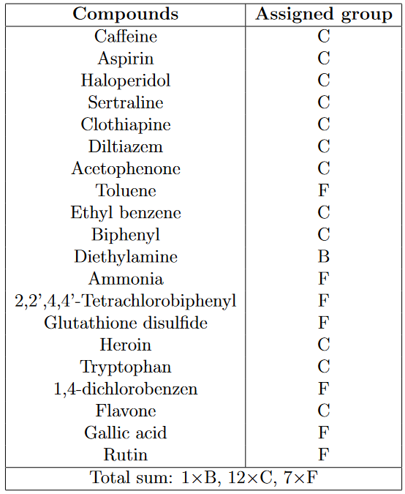
Assessment performance – Reverse literature search
What if we reverse our validation strategy?
Selection of 20 compounds from random scientific papers stating their analysis in a C18 column
Tracking these compounds in the NORMAN dataset and finding their assigned group
 | True positive | True negative
Predicted positive | 7 | 3
Predicted negative | 8 | 12
A
C
B
D
E
F
19

Slide 20
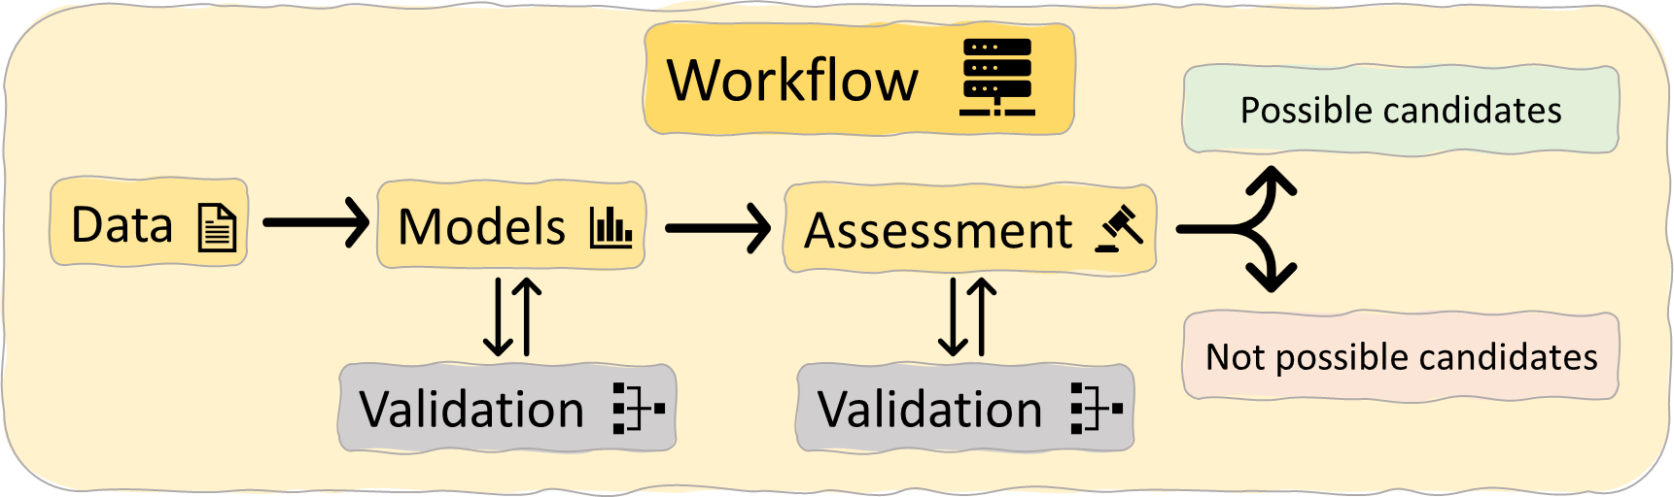
Final remarks
What was achieved?
What are the potentials of this study?
A novel workflow was developed to explore the theoretical space of compounds compatible with RPLC analysis in a C18 column
The NTA suspect list could be shortened
The suggested assessment showed a 63% accuracy, based on cross-validation with reported data
This would result in less challenging identification
A flexible approach is provided which could incorporate more elements in future studies and further increase its capabilities
20

Slide 21
Thank you for your attention!
Questions?
21

Slide 22
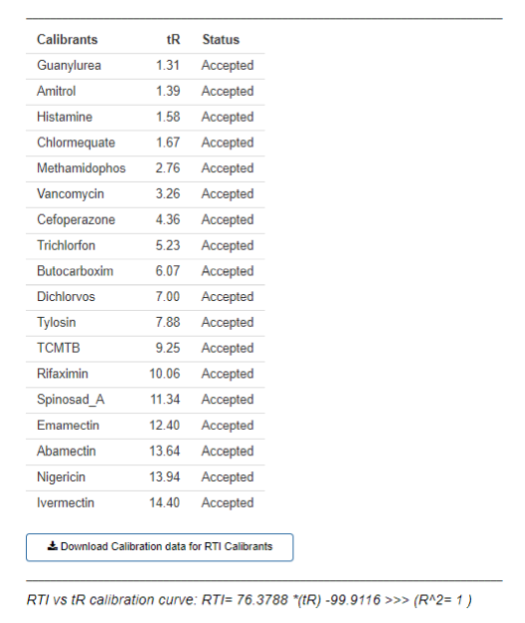
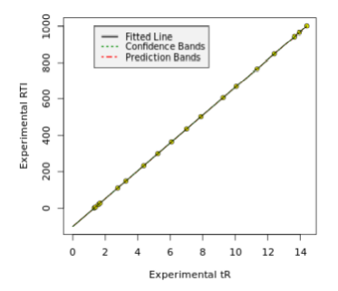
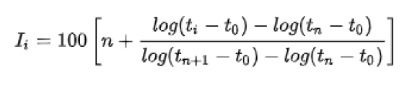
r_{i} explanation
Kovats index
UoA index
n-alkane homologous series
Ii equals the retention index
t0 the measured dead volume
ti the measured retention time of the analyte
n the number of carbons of the species in the homologous series that elutes right before the analyte
tn and tn+1 the retention times of the species within the series that elute right before and after the analyte.
22

Slide 23
How does random forest regression work?
Decision trees are the core of a random forest regressor
Every decision tree “asks questions” to the set of variables of every compound
Multiple decision trees are randomly created using different set of variables
The result of the random forest is equal to the average result of all the decision trees
Var1 > a
YES
NO
Var2 > b
Var3 < c
YES
NO
YES
NO
751
819
215
Var2 < d
YES
NO
355
378

Slide 24
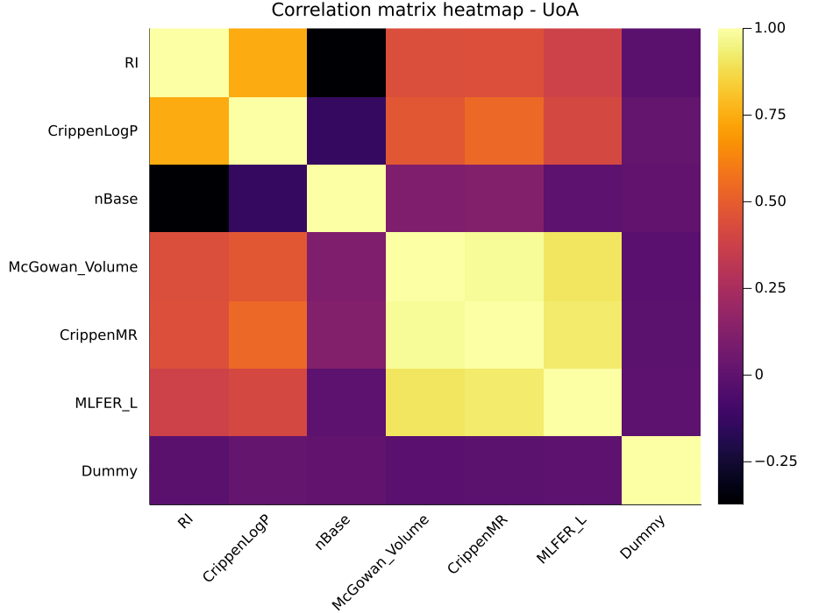
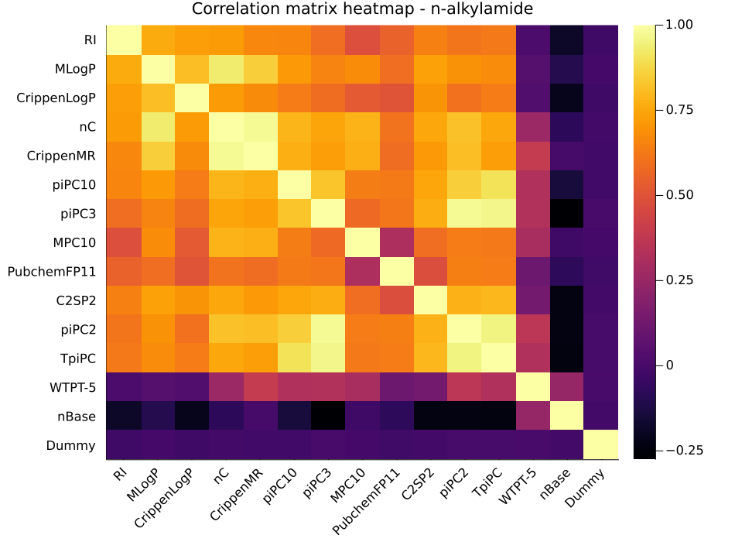
Correlation matrices
Molecular size
The count of carbon atoms (nC)
The presence of more than eight carbon atoms (PubchemFP11)
The count of molecular paths of low order, high order and their total sum (piPC2, piPC3, piPC10, MPC10 and TpiPC
Hydrophobicity
Mannhold’s logP (MLogP)
Crippen’s logP (CrippenLogP) and molar refractivity (CrippenMR)
Solute gas-hexadecane partition coefficient (MLFER_L)
McGowan characteristic volume (McGowan Volume)

Slide 25
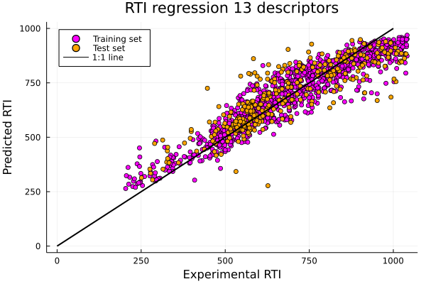
Partial Regression model – n-alkylamide dataset
Used descriptors
1 | MLogP
2 | CrippenLogP
3 | nC
4 | CrippenMR
5 | piPC3
6 | C2SP2
7 | piPC10
8 | MPC10
9 | piPC2
10 | PubchemFP11
11 | WTPT-5
12 | nBase
13 | MATS1e
R² (training set) = 0.88
R² (test set) = 0.73
Cross validation 5-fold average = 0.70

Slide 26
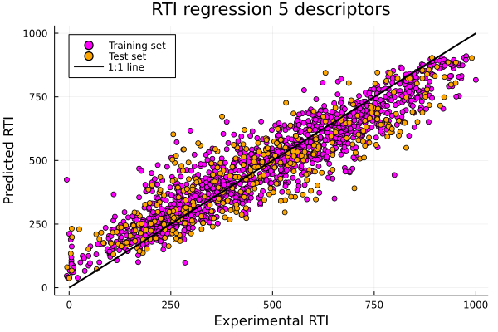
Partial Regression model – UoA dataset
Used descriptors
1 | CrippenLogP
2 | nBase
3 | McGowan_Volume
4 | CrippenMR
5 | MLFER_L
R² (training set) = 0.87
R² (test set) = 0.77
Cross validation 5-fold average = 0.74

Slide 27
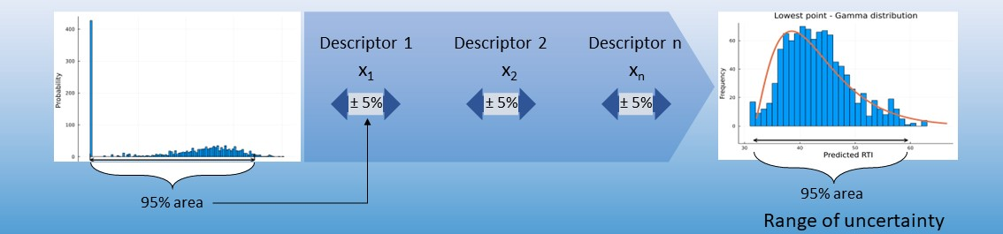
Assessment – Calculation of extrapolation region
Adjustment of the descriptor matrix around the original values of the lowest and highest point of the training set
Calculation of every descriptor 95% range
Fitting a gamma distribution and defining the 95% area as the uncertainty range

